Slide 1

Breathe Life Into Data: Unveiling Lung Cancer Insights
Name: Sumit Verma
Submission Date: 20-02-2025
Tools Used: SSMS, Power BI

Slide 2
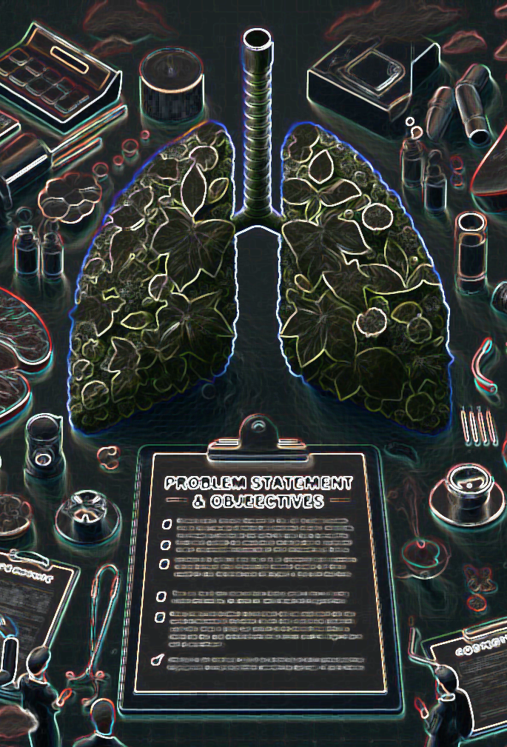
Problem Statement & Objectives
Problem Statement:
Lung cancer remains one of the deadliest diseases worldwide. The objective of this project is to analyze the given dataset to identify key risk factors, demographic patterns, and survival trends to improve early detection and treatment strategies.
Project Objectives:
Identify the impact of smoking, air pollution, and other risk factors on lung cancer prevalence.
Analyze mortality and survival rates across different patient demographics.
Determine the effectiveness of early detection in improving survival chances.
Provide actionable insights for healthcare decision-makers

Slide 3

Dataset Overview
Dataset Name: lung_cancer_Dataset
Columns Include:
Age, Gender, Smoker, Years of Smoking, Passive Smoker, Family History, Lung Cancer Diagnosis, Cancer Stage, Survival Years, Air Pollution Exposure, Treatment Type, etc.
Total Records: Over 220,000+ patient records
Data Processing:
Created new calculated columns for Impact Score and Risk Score categorization

Slide 4
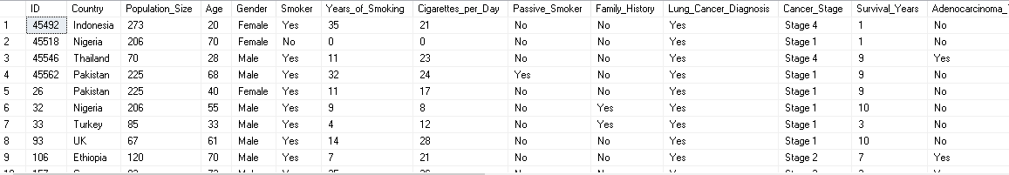
SQL Queries & Solutions
Basic Level
Retrieve all records for individuals diagnosed with lung cancer.
SELECT *
FROM Lung_Cancer_Analysis..lung_cancer_Dataset
WHERE Lung_Cancer_Diagnosis = 'Yes'

Slide 5
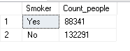
SQL Queries & Solutions
Basic Level
2. Count the number of smokers and non-smokers.
SELECT Smoker,COUNT(*) as Count_people
FROM Lung_Cancer_Analysis..lung_cancer_Dataset
GROUP BY SMOKER

Slide 6
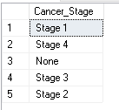
SQL Queries & Solutions
Basic Level
3. List all unique cancer stages present in the dataset.
SELECT DISTINCT Cancer_Stage
FROM lung_cancer_Dataset

Slide 7
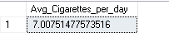
SQL Queries & Solutions
Basic Level
4. Retrieve the average number of cigarettes smoked per day by smokers.
SELECT AVG(Cigarettes_per_Day) as Avg_Cigarettes_per_day
FROM lung_cancer_Dataset

Slide 8
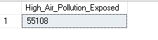
SQL Queries & Solutions
Basic Level
5. Count the number of people exposed to high air pollution.
SELECT COUNT(*) AS High_Air_Pollution_Exposed
FROM lung_cancer_Dataset
WHERE Air_Pollution_Exposure = 'High'

Slide 9
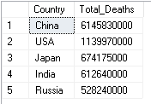
SQL Queries & Solutions
Basic Level
6. Find the top 5 countries with the highest lung cancer deaths.
SELECT TOP(5) Country,SUM(Annual_Lung_Cancer_Deaths) as Total_Deaths
FROM lung_cancer_Dataset
GROUP BY Country
ORDER BY Total_Deaths DESC

Slide 10
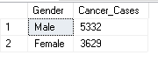
SQL Queries & Solutions
Basic Level
7. Count the number of people diagnosed with lung cancer by gender.
SELECT Gender, COUNT(*) as Cancer_Cases
FROM lung_cancer_Dataset
WHERE Lung_Cancer_Diagnosis = 'Yes'
GROUP BY Gender

Slide 11
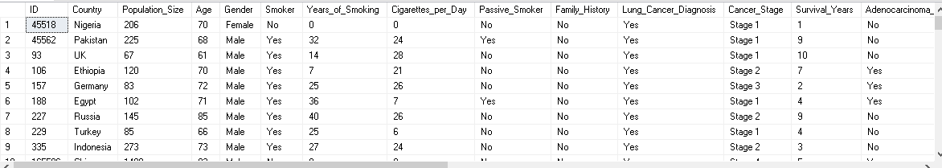
SQL Queries & Solutions
Basic Level
8. Retrieve records of individuals older than 60 who are diagnosed with lung cancer.
SELECT *
FROM lung_cancer_Dataset
WHERE Age > 60
AND Lung_Cancer_Diagnosis = 'Yes'

Slide 12
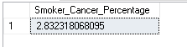
SQL Queries & Solutions
Intermediate Level
1. Find the percentage of smokers who developed lung cancer.
SELECT
(SUM(CASE WHEN Smoker = 'Yes' AND Lung_Cancer_Diagnosis = 'Yes' THEN 1 ELSE 0 END) * 100.0 / COUNT(*)) AS Smoker_Cancer_Percentage
FROM lung_cancer_Dataset;

Slide 13
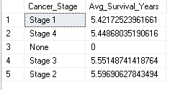
SQL Queries & Solutions
Intermediate Level
2. Calculate the average survival years based on cancer stages.
SELECT Cancer_Stage, AVG(Survival_Years) AS Avg_Survival_Years
FROM lung_cancer_Dataset
GROUP BY Cancer_Stage

Slide 14
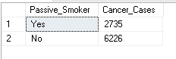
SQL Queries & Solutions
Intermediate Level
3. Count the number of lung cancer patients based on passive smoking.
SELECT Passive_Smoker, COUNT(*) as Cancer_Cases
FROM lung_cancer_Dataset
WHERE Lung_Cancer_Diagnosis = 'Yes'
GROUP BY Passive_Smoker

Slide 15
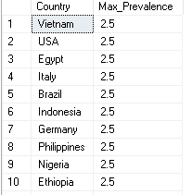
SQL Queries & Solutions
Intermediate Level
4. Find the country with the highest lung cancer prevalence rate.
SELECT Country, MAX(Lung_Cancer_Prevalence_Rate) as Max_Prevalence
FROM lung_cancer_Dataset
GROUP BY Country

Slide 16
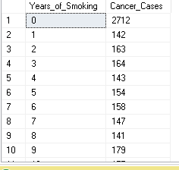
SQL Queries & Solutions
Intermediate Level
5. Identify the smoking years' impact on lung cancer.
SELECT Years_of_Smoking, COUNT(*) as Cancer_Cases
FROM lung_cancer_Dataset
WHERE Lung_Cancer_Diagnosis = 'Yes'
GROUP BY Years_of_Smoking
Order by Years_of_Smoking

Slide 17
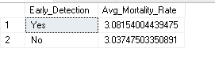
SQL Queries & Solutions
Intermediate Level
6. Determine the mortality rate for patients with and without early detection.
SELECT Early_Detection, AVG(Mortality_Rate) AS Avg_Mortality_Rate
FROM lung_cancer_Dataset
GROUP BY Early_Detection

Slide 18
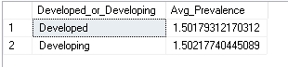
SQL Queries & Solutions
Intermediate Level
7. Group the lung cancer prevalence rate by developed vs. developing countries.
SELECT Developed_or_Developing, AVG(Lung_Cancer_Prevalence_Rate) AS Avg_Prevalence
FROM lung_cancer_Dataset
GROUP BY Developed_or_Developing

Slide 19
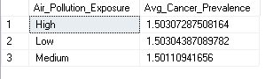
SQL Queries & Solutions
Advanced Level
1. Identify the correlation between lung cancer prevalence and air pollution levels.
SELECT Air_Pollution_Exposure, AVG(Lung_Cancer_Prevalence_Rate) AS Avg_Cancer_Prevalence
FROM lung_cancer_Dataset
GROUP BY Air_Pollution_Exposure
ORDER BY Avg_Cancer_Prevalence DESC

Slide 20
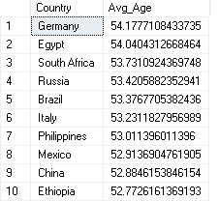
SQL Queries & Solutions
Advanced Level
2. Find the average age of lung cancer patients for each country.
SELECT Country, AVG(AGE) AS Avg_Age
FROM lung_cancer_Dataset
WHERE Lung_Cancer_Diagnosis = 'Yes'
GROUP BY Country
ORDER BY Avg_Age DESC

Slide 21
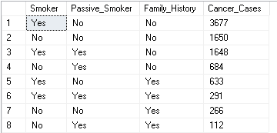
SQL Queries & Solutions
Advanced Level
3. Calculate the risk factor of lung cancer by smoker status, passive smoking, and family history.
SELECT Smoker, Passive_Smoker, Family_History, COUNT(*) AS Cancer_Cases
FROM lung_cancer_Dataset
WHERE Lung_Cancer_Diagnosis ='Yes'
GROUP BY Smoker, Passive_Smoker, Family_History
ORDER BY Cancer_Cases DESC

Slide 22
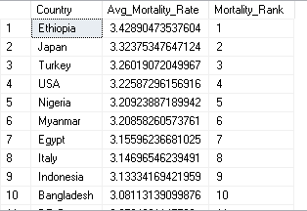
SQL Queries & Solutions
Advanced Level
4. Rank countries based on their mortality rate.
SELECT Country, AVG(Mortality_Rate) AS Avg_Mortality_Rate,
RANK() OVER(ORDER BY AVG(Mortality_Rate) DESC) AS Mortality_Rank
FROM lung_cancer_Dataset
GROUP BY Country

Slide 23
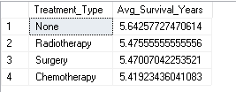
SQL Queries & Solutions
Advanced Level
5. Determine if treatment type has a significant impact on survival years.
SELECT Treatment_Type, AVG(Survival_Years) as Avg_Survival_Years
FROM lung_cancer_Dataset
WHERE Lung_Cancer_Diagnosis = 'YES'
GROUP BY Treatment_Type
ORDER BY Avg_Survival_Years DESC

Slide 24
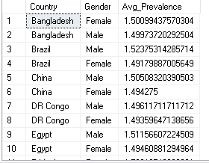
SQL Queries & Solutions
Advanced Level
6. Compare lung cancer prevalence in men vs. women across countries.
SELECT Country, Gender, AVG(Lung_Cancer_Prevalence_Rate) AS Avg_Prevalence
FROM lung_cancer_Dataset
GROUP BY Country, Gender
ORDER BY Country, Avg_Prevalence DESC

Slide 25
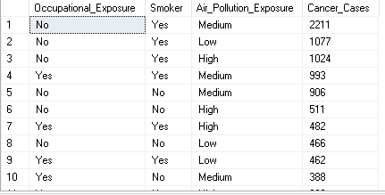
SQL Queries & Solutions
Advanced Level
7. Find how occupational exposure, smoking, and air pollution collectively impact lung cancer rates.
SELECT Occupational_Exposure, Smoker, Air_Pollution_Exposure,
COUNT(*) AS Cancer_Cases
FROM lung_cancer_Dataset
WHERE Lung_Cancer_Diagnosis = 'YES'
GROUP BY Occupational_Exposure, Smoker, Air_Pollution_Exposure
ORDER BY Cancer_Cases DESC

Slide 26
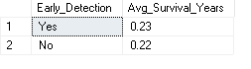
SQL Queries & Solutions
Advanced Level
8. Analyze the impact of early detection on survival years.
SELECT Early_Detection, ROUND(AVG(Survival_Years),2) AS Avg_Survival_Years
FROM lung_cancer_Dataset
GROUP BY Early_Detection
ORDER BY Avg_Survival_Years DESC

Slide 27
Data Visualization & Dashboard
📊 Lung Cancer Overview
8,961 total cases, 52.66 avg. patient age, 2.83% smokers with lung cancer, 75.09 avg.mortality rate.
Males have higher lung cancer cases than females.
Risk Score Distribution: Low (177K), Medium (35.8K), High (7.5K).Medium air pollution exposure leads to the highest mortality.
Adults (ages 25-64) have the highest lung cancer cases.
Top 10 affected countries: Ethiopia, Japan, Turkey, Nigeria, USA, Myanmar, Italy, Egypt, Indonesia, France.
Dashboard →→→ NEXT SLIDE

Slide 28
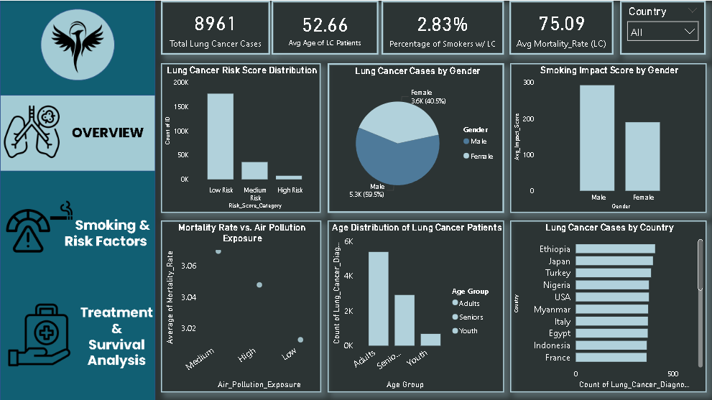

Slide 29
Data Visualization & Dashboard
📊 Smoking & Risk Factors
88.34K total smokers, 20.42 avg. smoking years, 127.67K high-risk patients, 27.97% early detection rate.
Smoking significantly increases lung cancer risk, but pollution is also a major factor.
Long-term smoking is linked to advanced cancer stages (Stage 4 & Stage 2).
Passive smoking has no significant correlation with lung cancer cases.
Early detection greatly improves survival chances.
Dashboard →→→ NEXT SLIDE

Slide 30
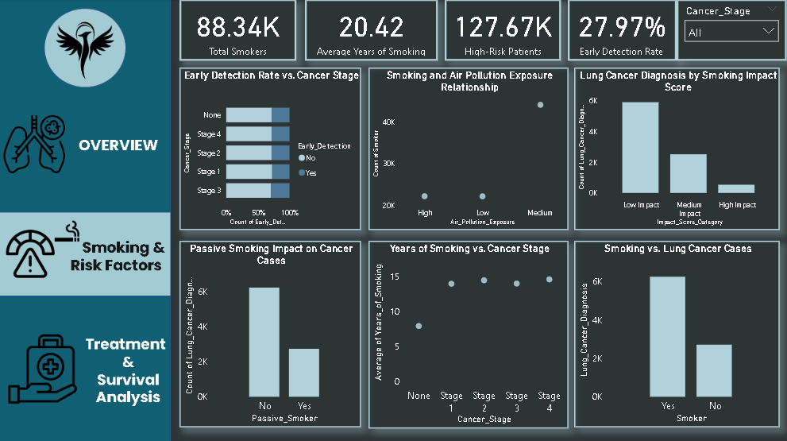

Slide 31
Data Visualization & Dashboard
📊 Treatment & Survival Analysis
0.22 avg. survival years, 14bn total annual lung cancer deaths, 1.50 prevalence rate, 4.12% survival rate for early detection.
Males have slightly higher survival rates than females.
Top 10 countries with the highest lung cancer deaths: China, USA, Japan, India, Russia, Germany, Brazil, Myanmar, UK, France.
All treatment types (Surgery, Radiation, Chemo, None) show similar survival & mortality rates.
Similar lung cancer prevalence in developed & developing nations.
No significant difference in survival across cancer stages.
Dashboard →→→ NEXT SLIDE

Slide 32
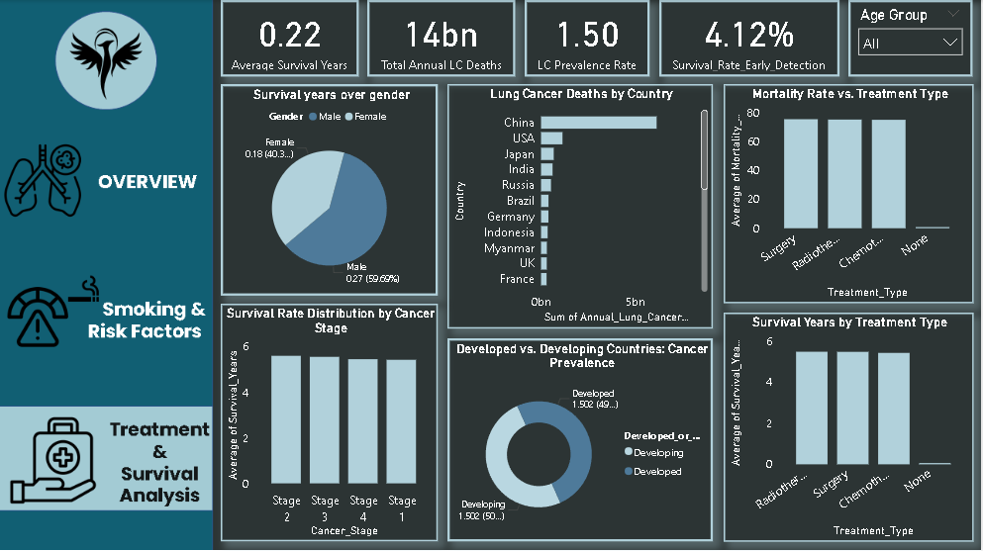

Slide 33
Conclusion & Business Recommendations
✅ Key Findings:
Both smoking & pollution significantly impact lung cancer risk.
Early detection is critical—it significantly improves survival rates.
Treatment type does not impact survival much—prevention & early diagnosis matter more.
Lung cancer is a global issue, affecting both developed & developing countries.

Slide 34
Conclusion & Business Recommendations
📌 Business Recommendations:
Promote awareness campaigns on air pollution control & smoking cessation.
Invest in early screening programs, as early detection improves survival rates.
Focus on personalized prevention strategies based on risk factors (smoking, pollution exposure, etc.).
Strengthen healthcare infrastructure for both developed and developing nations to ensure equal access to treatment.

Slide 35
References & Acknowledgments
Data Source:
Provided by the challenge (Futurion Tech).
Tools Used:
SQL (SSMS) for data analysis, Power BI for visualization.
Acknowledgments:
Thanks to Futurion Tech for organizing this challenge and providing an opportunity to work on a real-world dataset.

Slide 36

🎉 Thank You! 🎉
🙏 Feel free to connect for any discussions or feedback! 🙏
📩 Email: vsumitwork@gmail.com 🔗 LinkedIn: https://www.linkedin.com/in/vsumitwork
🚀 Looking forward to more data-driven insights! 🚀

